Slide 1

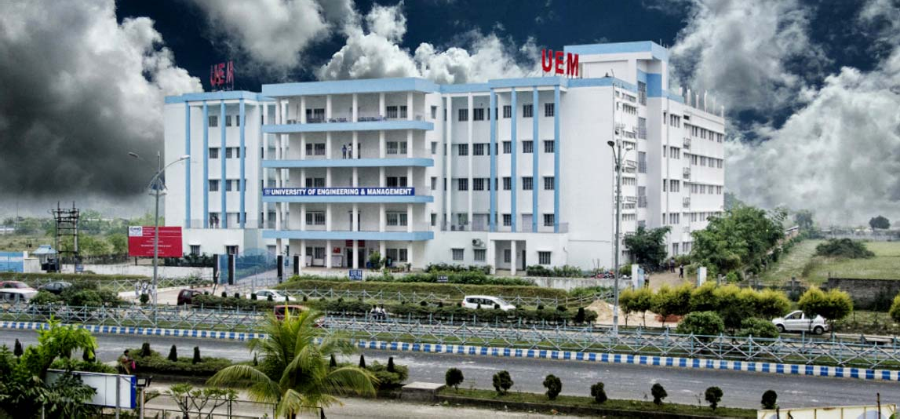
UNIVERSITY OF ENGINEERING & MANAGEMENT, KOLKATA
Course Name : Operating System Class

Slide 2


UNIVERSITY OF ENGINEERING & MANAGEMENT, KOLKATA
One of the important jobs of an Operating System is to manage various I/O devices including mouse, keyboards, touch pad, disk drives, display adapters, USB devices, Bit-mapped screen, LED, Analog-to-digital converter, On/off switch, network connections, audio I/O, printers etc.
An I/O system is required to take an application I/O request and send it to the physical device, then take whatever response comes back from the device and send it to the application. I/O devices can be divided into two categories −
Block devices − A block device is one with which the driver communicates by sending entire blocks of data. For example, Hard disks, USB cameras, Disk-On-Key etc.
Character devices − A character device is one with which the driver communicates by sending and receiving single characters (bytes, octets). For example, serial ports, parallel ports, sounds cards etc
2

Slide 3
UNIVERSITY OF ENGINEERING & MANAGEMENT, KOLKATA
Device Controllers:
Device drivers are software modules that can be plugged into an OS to handle a particular device. Operating System takes help from device drivers to handle all I/O devices.
The Device Controller works like an interface between a device and a device driver. I/O units (Keyboard, mouse, printer, etc.) typically consist of a mechanical component and an electronic component where electronic component is called the device controller.
There is always a device controller and a device driver for each device to communicate with the Operating Systems.
A device controller may be able to handle multiple devices. As an interface its main task is to convert serial bit stream to block of bytes, perform error correction as necessary.
3

Slide 4
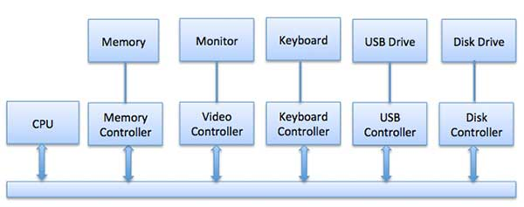
UNIVERSITY OF ENGINEERING & MANAGEMENT, KOLKATA
Any device connected to the computer is connected by a plug and socket, and the socket is connected to a device controller. Following is a model for connecting the CPU, memory, controllers, and I/O devices where CPU and device controllers all use a common bus for communication
4

Slide 5
UNIVERSITY OF ENGINEERING & MANAGEMENT, KOLKATA
Synchronous vs Asynchronous I/O
Synchronous I/O − In this scheme CPU execution waits while I/O proceeds
Asynchronous I/O − I/O proceeds concurrently with CPU execution
Communication to I/O Devices
The CPU must have a way to pass information to and from an I/O device. There are three approaches available to communicate with the CPU and Device.
Special Instruction I/O
Memory-mapped I/O
Direct memory access (DMA)
5

Slide 6
UNIVERSITY OF ENGINEERING & MANAGEMENT, KOLKATA
Communication to I/O Devices
The CPU must have a way to pass information to and from an I/O device. There are three approaches available to communicate with the CPU and Device.
Special Instruction I/O
Memory-mapped I/O
Direct memory access (DMA)
Special Instruction I/O
This uses CPU instructions that are specifically made for controlling I/O devices. These instructions typically allow data to be sent to an I/O device or read from an I/O device.
6

Slide 7
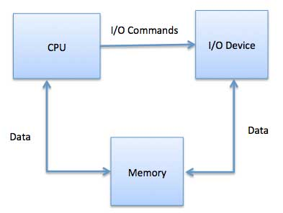
UNIVERSITY OF ENGINEERING & MANAGEMENT, KOLKATA
Memory-mapped I/O:
When using memory-mapped I/O, the same address space is shared by memory and I/O devices. The device is connected directly to certain main memory locations so that I/O device can transfer block of data to/from memory without going through CPU.
While using memory mapped IO, OS allocates buffer in memory and informs I/O device to use that buffer to send data to the CPU. I/O device operates asynchronously with CPU, interrupts CPU when finished.
The advantage to this method is that every instruction which can access memory can be used to manipulate an I/O device. Memory mapped IO is used for most high-speed I/O devices like disks, communication interfaces.
7

Slide 8
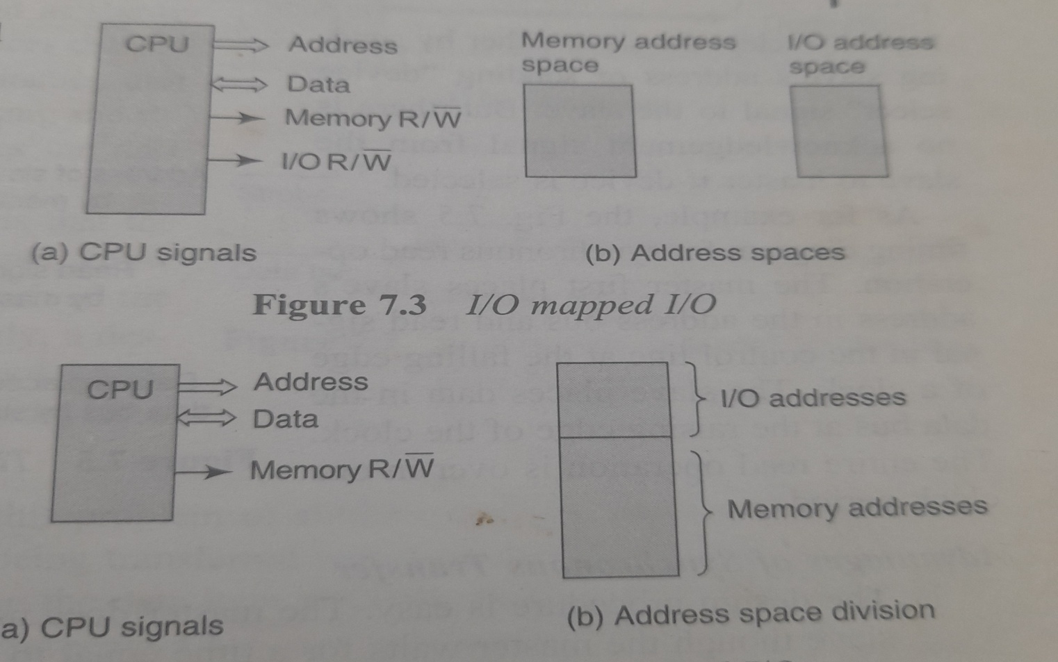

Slide 9
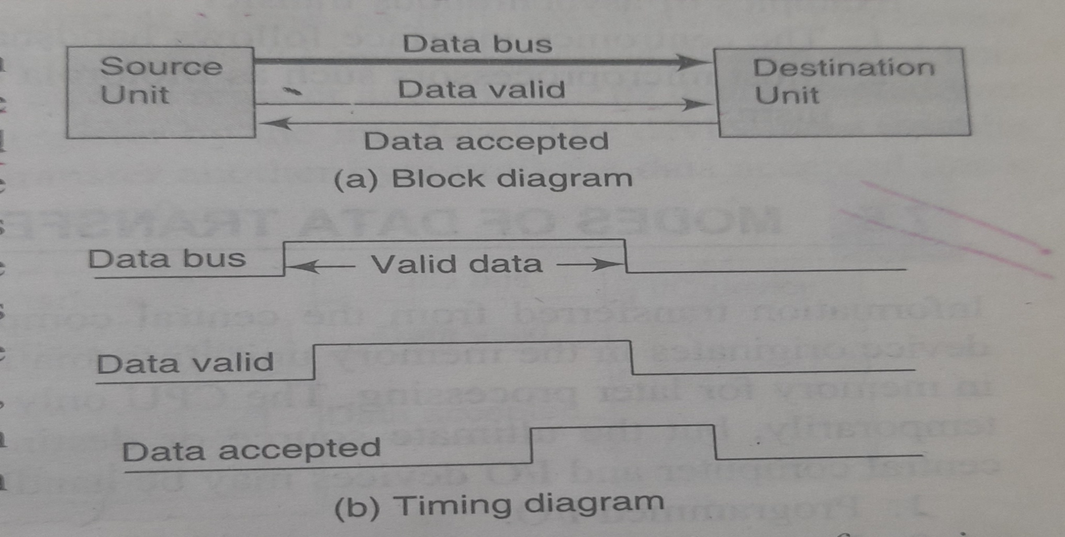

Slide 10
UNIVERSITY OF ENGINEERING & MANAGEMENT, KOLKATA
Direct Memory Access (DMA)
Slow devices like keyboards will generate an interrupt to the main CPU after each byte is transferred. If a fast device such as a disk generated an interrupt for each byte, the operating system would spend most of its time handling these interrupts. So a typical computer uses direct memory access (DMA) hardware to reduce this overhead.
Direct Memory Access (DMA) means CPU grants I/O module authority to read from or write to memory without involvement. DMA module itself controls exchange of data between main memory and the I/O device. CPU is only involved at the beginning and end of the transfer and interrupted only after entire block has been transferred.
Direct Memory Access needs a special hardware called DMA controller (DMAC) that manages the data transfers and arbitrates access to the system bus. The controllers are programmed with source and destination pointers (where to read/write the data), counters to track the number of transferred bytes, and settings, which includes I/O and memory types, interrupts and states for the CPU cycles
10

Slide 11
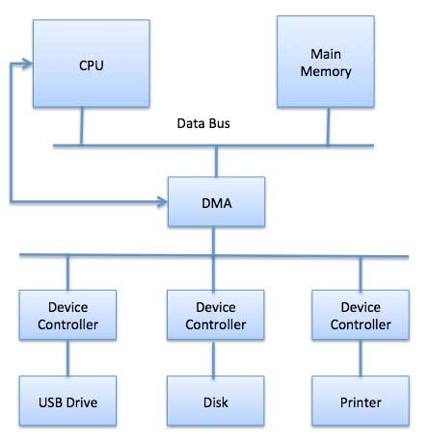
UNIVERSITY OF ENGINEERING & MANAGEMENT, KOLKATA
11

Slide 12
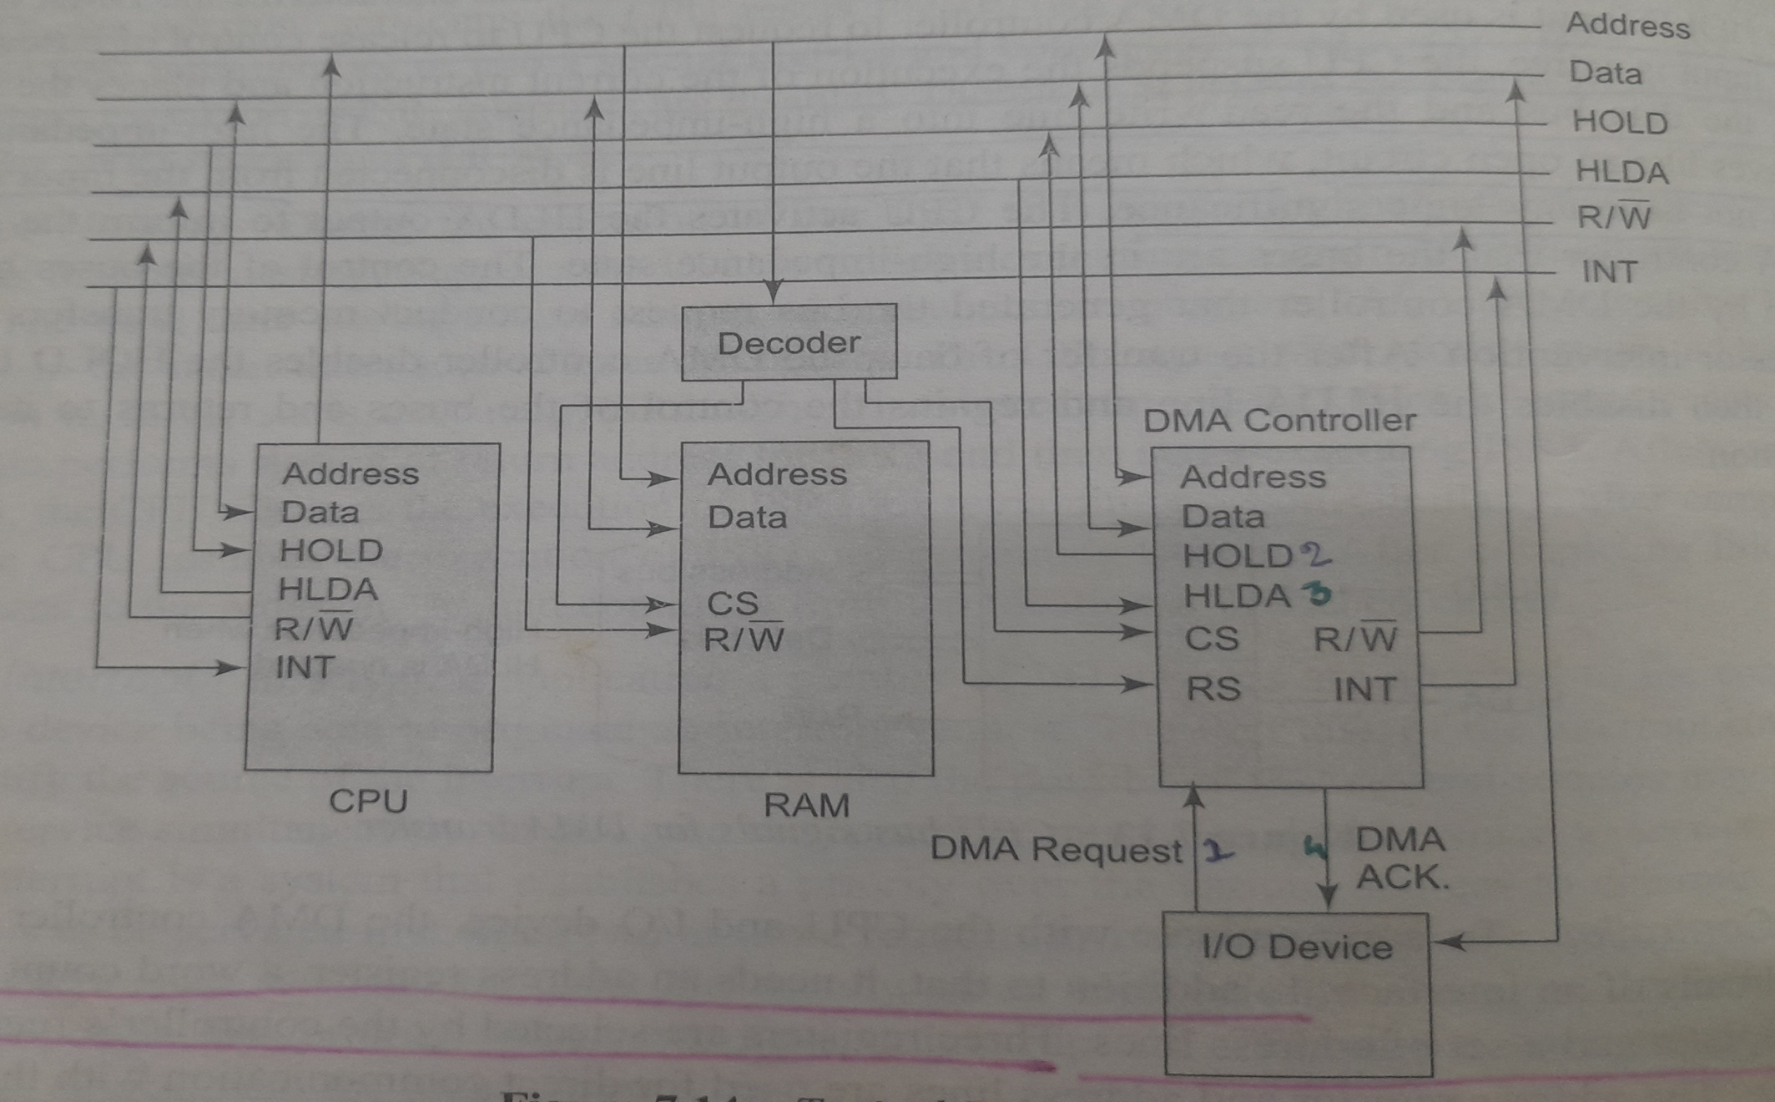
DMA

Slide 13
UNIVERSITY OF ENGINEERING & MANAGEMENT, KOLKATA
Step | Description
1 | Device driver is instructed to transfer disk data to a buffer address X.
2 | Device driver then instruct disk controller to transfer data to buffer.
3 | Disk controller starts DMA transfer.
4 | Disk controller sends each byte to DMA controller.
5 | DMA controller transfers bytes to buffer, increases the memory address, decreases the counter C until C becomes zero.
6 | When C becomes zero, DMA interrupts CPU to signal transfer completion.
13

Slide 14
UNIVERSITY OF ENGINEERING & MANAGEMENT, KOLKATA
Polling vs Interrupts I/O
A computer must have a way of detecting the arrival of any type of input. There are two ways that this can happen, known as polling and interrupts. Both of these techniques allow the processor to deal with events that can happen at any time and that are not related to the process it is currently running.
Polling I/O
Polling is the simplest way for an I/O device to communicate with the processor. The process of periodically checking status of the device to see if it is time for the next I/O operation, is called polling. The I/O device simply puts the information in a Status register, and the processor must come and get the information.
Most of the time, devices will not require attention and when one does it will have to wait until it is next interrogated by the polling program. This is an inefficient method and much of the processors time is wasted on unnecessary polls.
Compare this method to a teacher continually asking every student in a class, one after another, if they need help. Obviously the more efficient method would be for a student to inform the teacher whenever they require assistance.
14

Slide 15
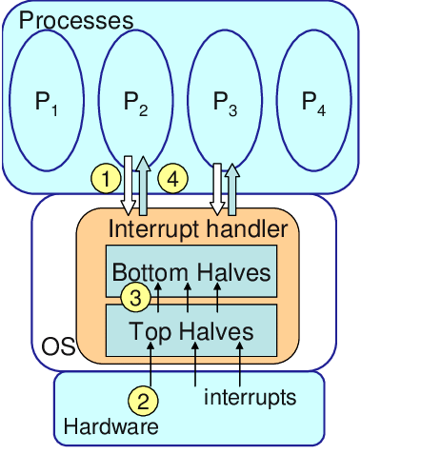

Slide 16
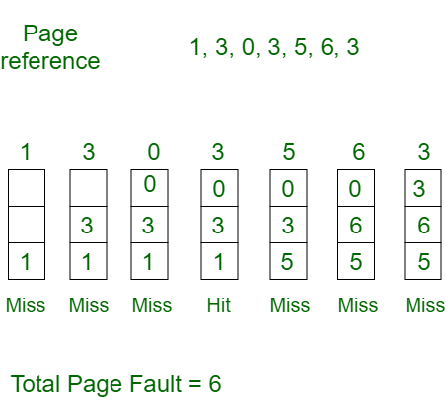
UNIVERSITY OF ENGINEERING & MANAGEMENT, KOLKATA
Page Replacement Algorithms :
1. First In First Out (FIFO) – This is the simplest page replacement algorithm. In this algorithm, the operating system keeps track of all pages in the memory in a queue, the oldest page is in the front of the queue. When a page needs to be replaced page in the front of the queue is selected for removal. Example-1Consider page reference string 1, 3, 0, 3, 5, 6, 3 with 3 page frames . Find the number of page faults.
.
16

Slide 17
UNIVERSITY OF ENGINEERING & MANAGEMENT, KOLKATA
Initially, all slots are empty, so when 1, 3, 0 came they are allocated to the empty slots —> 3 Page Faults. when 3 comes, it is already in memory so —> 0 Page Faults. Then 5 comes, it is not available in memory so it replaces the oldest page slot i.e 1. —>1 Page Fault. 6 comes, it is also not available in memory so it replaces the oldest page slot i.e 3 —>1 Page Fault.
Finally, when 3 come it is not available so it replaces 0 1 page fault
Belady’s anomaly – Belady’s anomaly proves that it is possible to have more page faults when increasing the number of page frames while using the First in First Out (FIFO) page replacement algorithm. For example, if we consider reference string 3, 2, 1, 0, 3, 2, 4, 3, 2, 1, 0, 4 and 3 slots, we get 9 total page faults, but if we increase slots to 4, we get 10-page faults.
17

Slide 18
UNIVERSITY OF ENGINEERING & MANAGEMENT, KOLKATA
Example-3:Consider the page references 7, 0, 1, 2, 0, 3, 0, 4, 2, 3, 0, 3, 2, with 5 page frame. Find number of page fault.
2. Optimal Page replacement – In this algorithm, pages are replaced which would not be used for the longest duration of time in the future. Example-2:Consider the page references 7, 0, 1, 2, 0, 3, 0, 4, 2, 3, 0, 3, 2, with 4 page frame. Find number of page fault.
Initially, all slots are empty, so when 7 0 1 2 are allocated to the empty slots —> 4 Page faults 0 is already there so —> 0 Page fault. when 3 came it will take the place of 7 because it is not used for the longest duration of time in the future.—>1 Page fault. 0 is already there so —> 0 Page fault.. 4 will takes place of 1 —> 1 Page Fault.
Now for the further page reference string —> 0 Page fault because they are already available in the memory. Optimal page replacement is perfect, but not possible in practice as the operating system cannot know future requests. The use of Optimal Page replacement is to set up a benchmark so that other replacement algorithms can be analyzed against it.
18

Slide 19
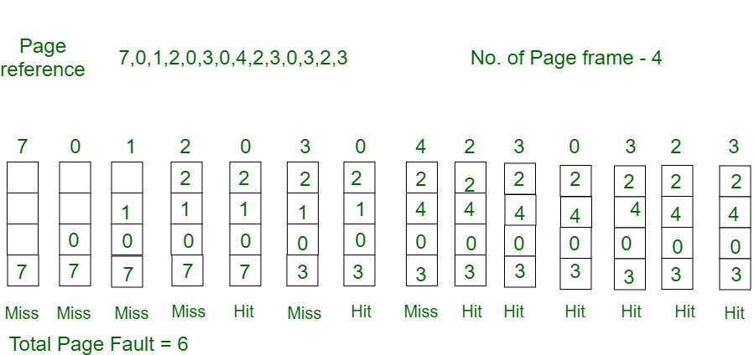
UNIVERSITY OF ENGINEERING & MANAGEMENT, KOLKATA
.
7, 0, 1, 2, 0, 3, 0, 4, 2, 3, 0, 3, 2
19

Slide 20
UNIVERSITY OF ENGINEERING & MANAGEMENT, KOLKATA
Least Recently Used – In this algorithm, page will be replaced which is least recently used. Example-3Consider the page reference string 7, 0, 1, 2, 0, 3, 0, 4, 2, 3, 0, 3, 2 with 4 page frames. Find number of page faults.
Initially, all slots are empty, so when 7 0 1 2 are allocated to the empty slots —> 4 Page faults 0 is already their so —> 0 Page fault. when 3 came it will take the place of 7 because it is least recently used —>1 Page fault 0 is already in memory so —> 0 Page fault. 4 will takes place of 1 —> 1 Page Fault Now for the further page reference string —> 0 Page fault because they are already available in the memory.
20

Slide 21
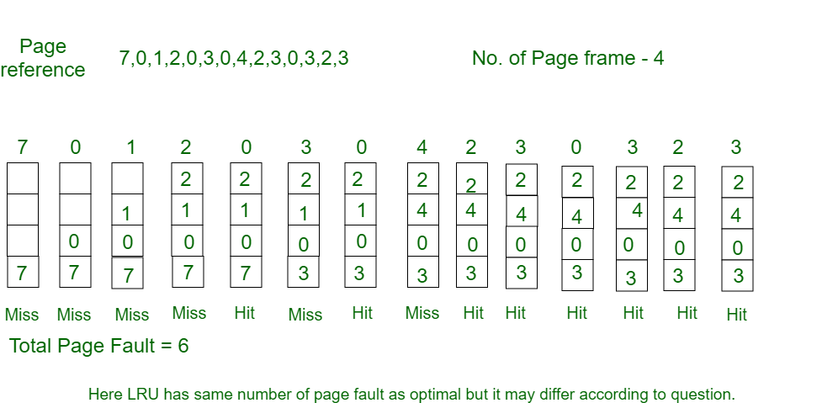
UNIVERSITY OF ENGINEERING & MANAGEMENT, KOLKATA
21

Slide 22
UNIVERSITY OF ENGINEERING & MANAGEMENT, KOLKATA
Thrashing is a condition or a situation when the system is spending a major portion of its time servicing the page faults, but the actual processing done is very negligible.
Thrashing’s Causes
Thrashing has an impact on the operating system’s execution performance. Thrashing also causes serious performance issues with the operating system. When the CPU’s usage is low, the process scheduling mechanism tries to load multiple processes into memory at the same time, increasing the degree of Multi programming.
In this case, the number of processes in the memory exceeds the number of frames available in the memory. Each process is given a set number of frames to work with.
Solution: Long term scheduling
22

Slide 23
UNIVERSITY OF ENGINEERING & MANAGEMENT, KOLKATA
If a high-priority process arrives in memory and the frame is not vacant at the moment, the other process occupying the frame will be moved to secondary storage, and the free frame will be allotted to a higher-priority process.
We may also argue that as soon as the memory is full, the procedure begins to take a long time to swap in the required pages. Because most of the processes are waiting for pages, the CPU utilization drops again.
As a result, a high level of multi programming and a lack of frames are two of the most common reasons for thrashing in the operating system.
23

Slide 24
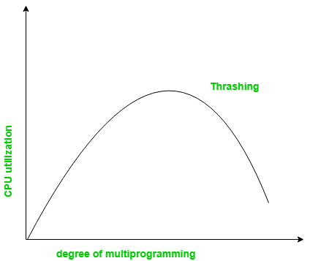
UNIVERSITY OF ENGINEERING & MANAGEMENT, KOLKATA
The basic concept involved is that if a process is allocated too few frames, then there will be too many and too frequent page faults. As a result, no useful work would be done by the CPU and the CPU utilization would fall drastically.
The long-term scheduler would then try to improve the CPU utilization by loading some more processes into the memory thereby increasing the degree of multi programming. This would result in a further decrease in the CPU utilization triggering a chained reaction of higher page faults followed by an increase in the degree of multi programming, called Thrashing.
24

Slide 25

UNIVERSITY OF ENGINEERING & MANAGEMENT, KOLKATA
Thank You
25

